Slide 1
9- Map Function

Slide 2
context
transform or map our list into a different list with for 3
map(function, oneOrMoreIterable) : mapObject | built in function 4
Ex.1 5
list(mapObject) | built in function 7

Slide 3
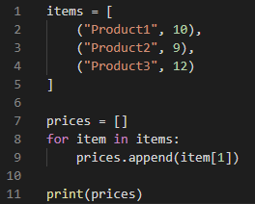
transform or map our list into a different list with for
With this code we have transformed or mapped our original list into a different list

Slide 4
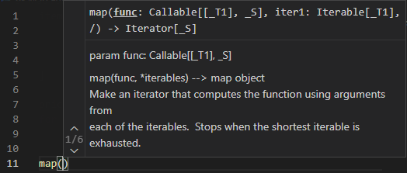
map(function, oneOrMoreIterable) | built in fucntion
This map function will apply this function on each item of this iterable.

Slide 5
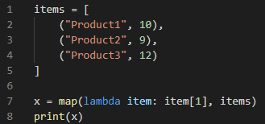
Ex.1
this map function returns a map object which is another iterable.

Slide 6
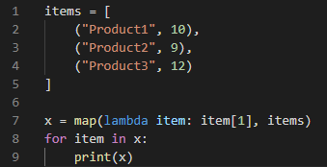


Slide 7
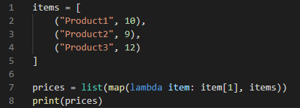
list(mapObject) | built in function
Earlier you learn that you can pass any iterables to this list function to create a new list

